Slide 1
Algorithmic Paradigms: Mastering D&C, DP & Greedy Strategies
Zohaib Ali

Slide 2
Divide and Conquer Algorithm
A divide and conquer algorithm is a strategy of solving a large problem by
breaking the problem into smaller sub-problems
solving the sub-problems, and
combining them to get the desired output.
To use the divide and conquer algorithm, recursion is used.

Slide 3
How Divide and Conquer Algorithms Work?
Here are the steps involved:
Divide: Divide the given problem into sub-problems using recursion.
Conquer: Solve the smaller sub-problems recursively. If the subproblem is small enough, then solve it directly.
Combine: Combine the solutions of the sub-problems that are part of the recursive process to solve the actual problem.
Let us understand this concept with the help of an example.
Here, we will sort an array using the divide and conquer approach (ie. merge sort).

Slide 4
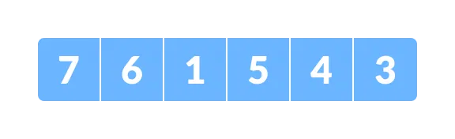
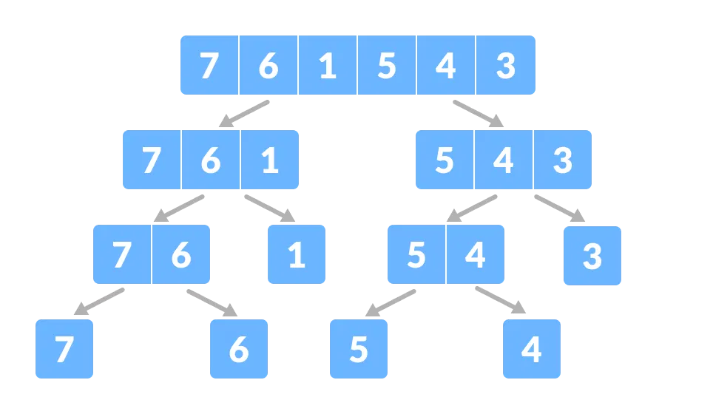
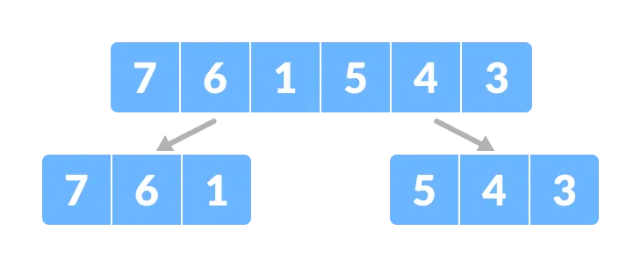
Merger Sort Example
Let the given array be:
Divide the array into two halves.
Again, divide each subpart recursively into two halves until you get individual elements.
Array for merge sort
Figure: Divide the array into two subparts
Figure: Divide the array into smaller subparts

Slide 5
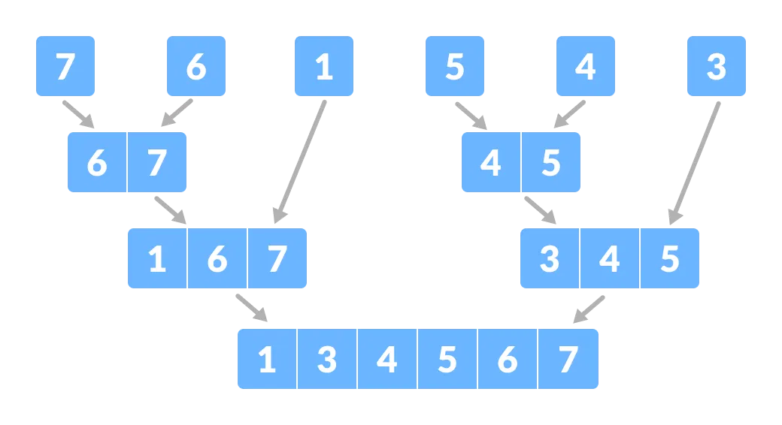
Merger Sort Example…
Again, divide each subpart recursively into two halves until you get individual elements.
Now, combine the individual elements in a sorted manner. Here, conquer and combine steps go side by side.
Figure: Divide the array into smaller subparts
Figure: Combine the subparts

Slide 6
What is Dynamic Programming?
Dynamic Programming (DP) is a method for solving complex problems by breaking them into smaller overlapping subproblems.
By solving each subproblem only once and storing its result, DP avoids redundant computations, making it highly efficient for specific types of problems.
Real-Life Analogy
Imagine you're planning a road trip and want to visit several cities with the least cost. You might:
Calculate the cost of all routes from your starting city to the next city.
Store the cheapest cost to each city.
Reuse this information as you calculate costs to subsequent cities.

Slide 7
Why Dynamic Programming?
Dynamic programming is essential for solving problems with:
1. Overlapping Subproblems
These are problems where the same problem is solved multiple times.
2. Optimal Substructure
In such problems, the optimal solution of the problem can be constructed from the optimal solutions of its subproblems.

Slide 8
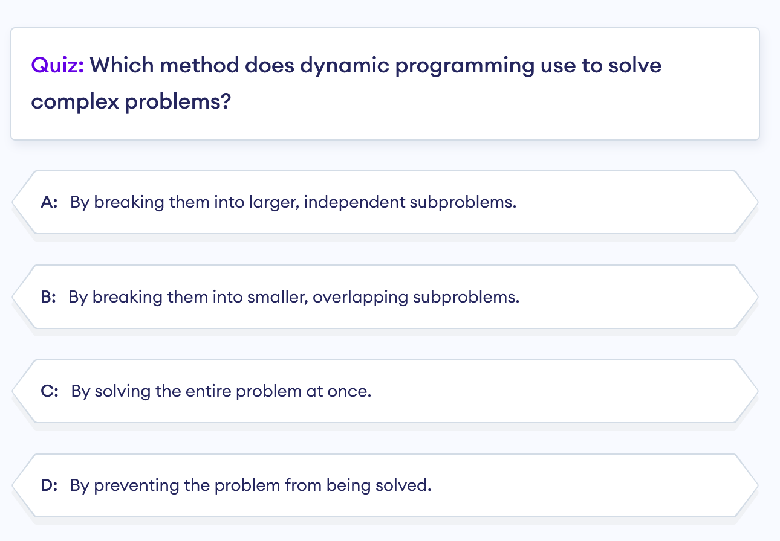

Slide 9
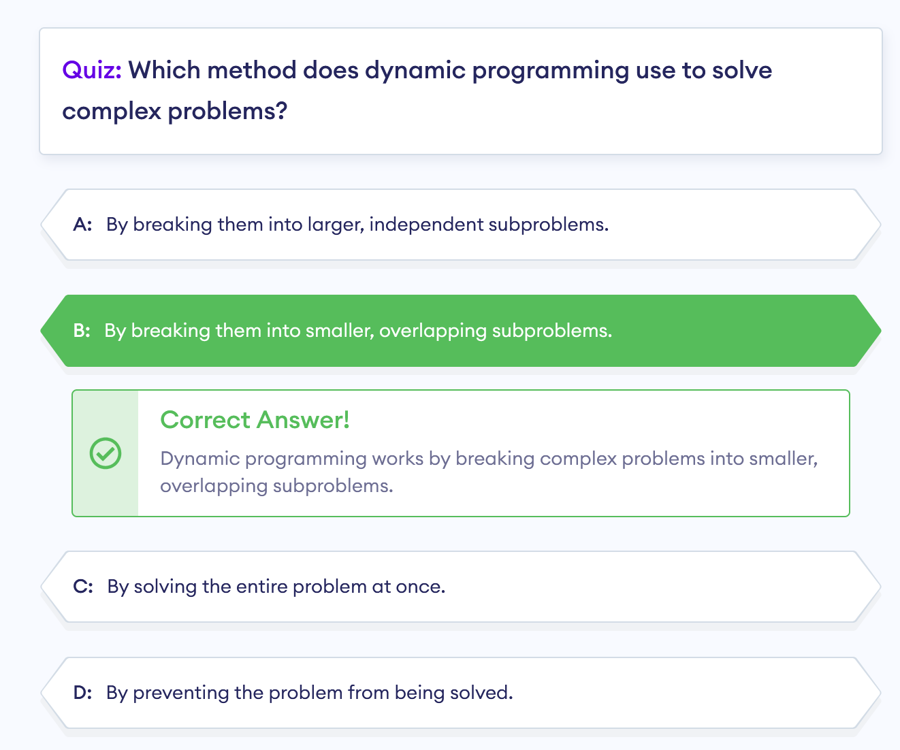

Slide 10
Overlapping Subproblems Property
Sometimes, the same subproblem occurs multiple times during the computation of a larger problem. Such problems are known as overlapping subproblems.
Dynamic programming frees us from the need of solving these subproblems each and every time. Instead, you can just save the solution and reuse it when you face the subproblem again.
By reusing previously computed results, you reduce the redundancy and enhance performance.
Real-Life Analogy
Imagine preparing dinner, where multiple dishes in your menu require chopped onions.
Instead of chopping onions separately each time you prepare a dish, you prepare a batch in advance and use them whenever needed.
As a result, you save a lot of time and effort, which is just like reusing computed results.

Slide 11
Optimal Substructure Property
Optimal substructure refers to the principle that the solution to a problem can be constructed efficiently from the solutions to its subproblems.
In dynamic programming, the optimal substructure property guides us to break down complex problems into manageable subproblems, allowing us to build up a solution efficiently by combining smaller solutions.
Real-Life Analogy
Think of constructing a complex Lego structure. Each small Lego piece represents a solution to a subproblem. By efficiently assembling these pieces, you create the entire intricate structure.
Now that you have some idea about dynamic programming, let's see how we can implement it.

Slide 12
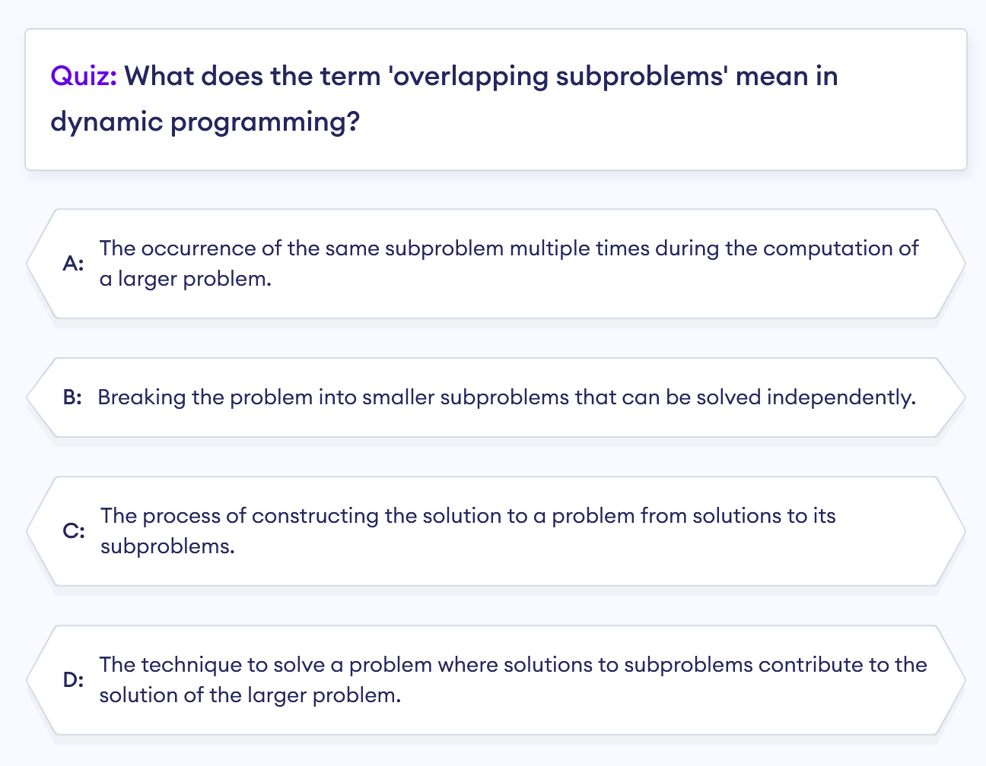

Slide 13
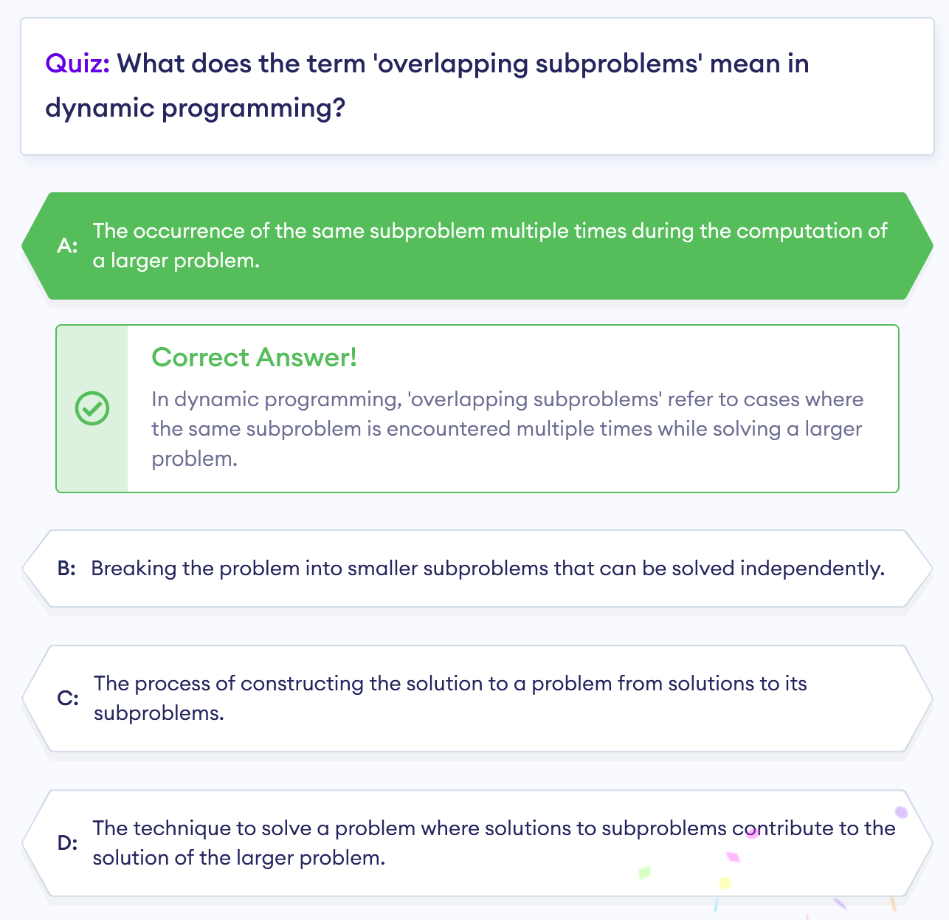

Slide 14
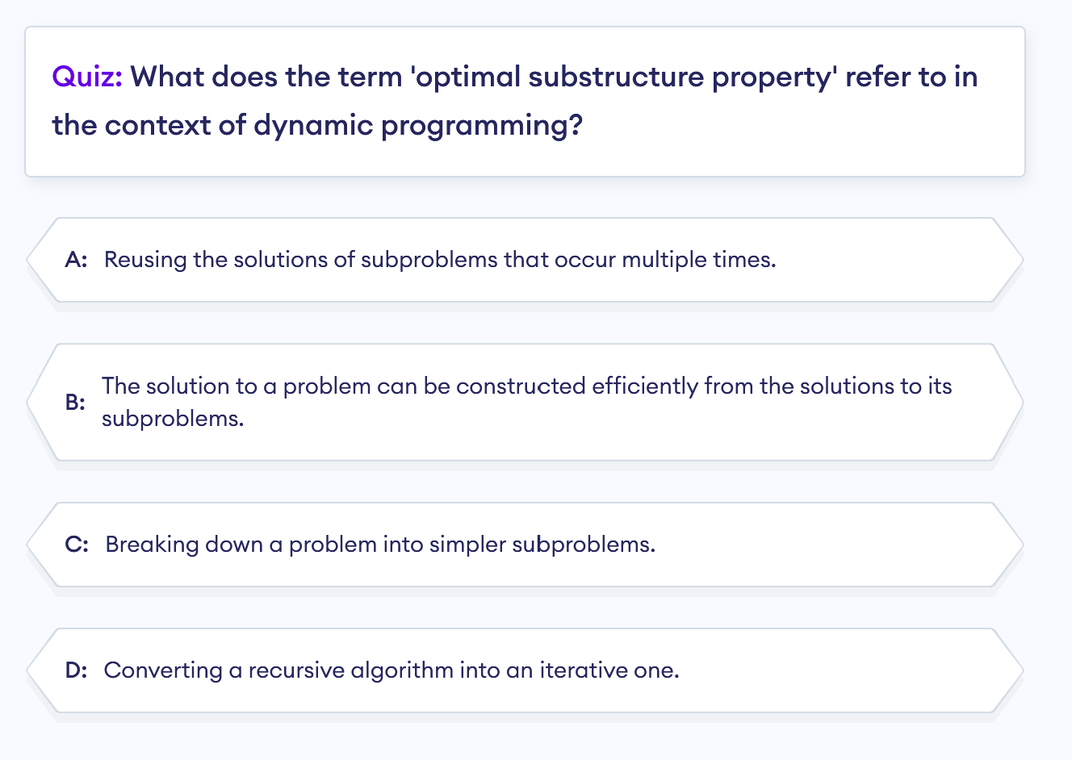

Slide 15
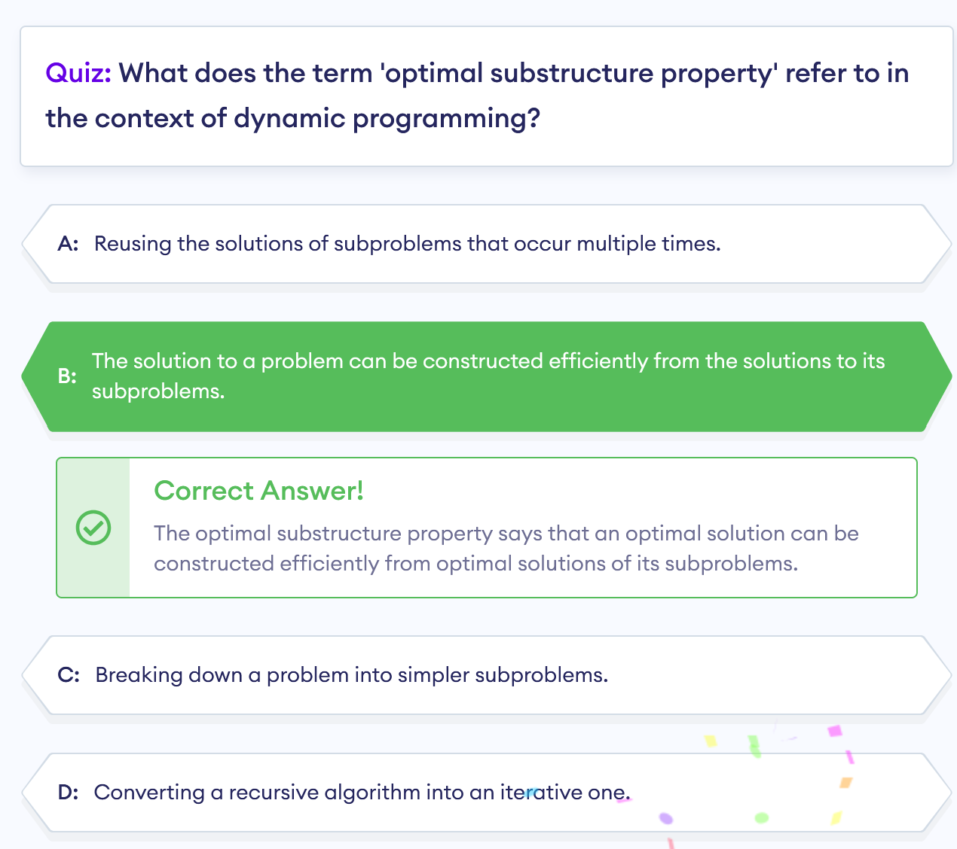

Slide 16
Pros and Cons of the Optimized Approach
Advantage: Reduced Time Complexity
The optimized approach eliminates the need for nested loops. Instead, it processes the vector in a single pass, making the time complexity O(n).
Acceptable Disadvantage: Increased Space Complexity
The seen set requires additional space proportional to the size of the vector. However, this tradeoff is often acceptable for the gain in performance.

Slide 17
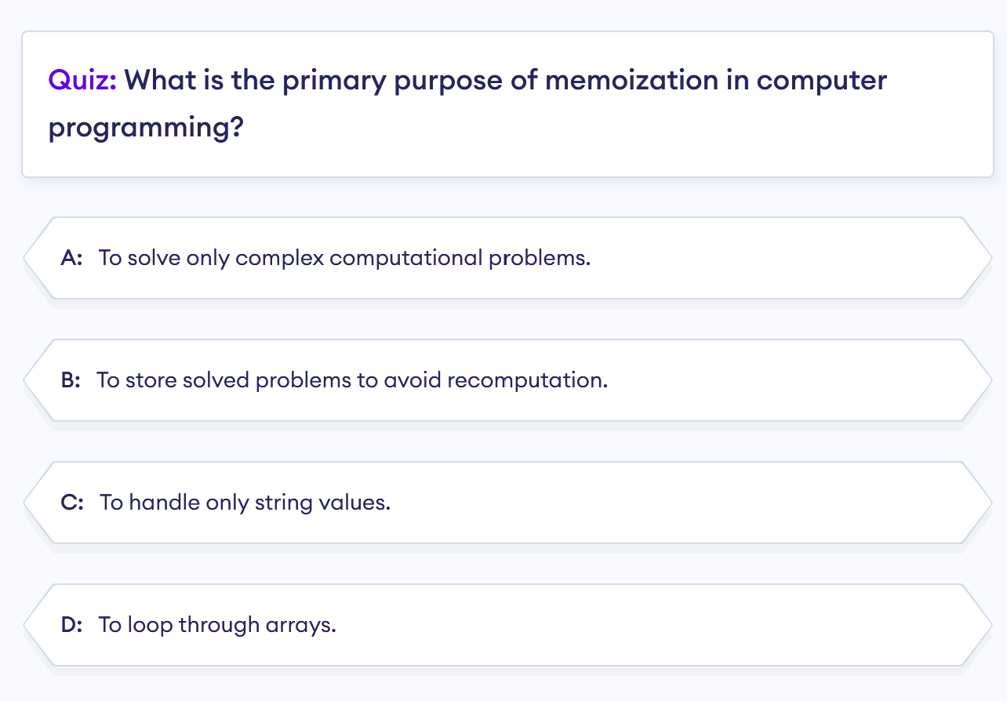

Slide 18
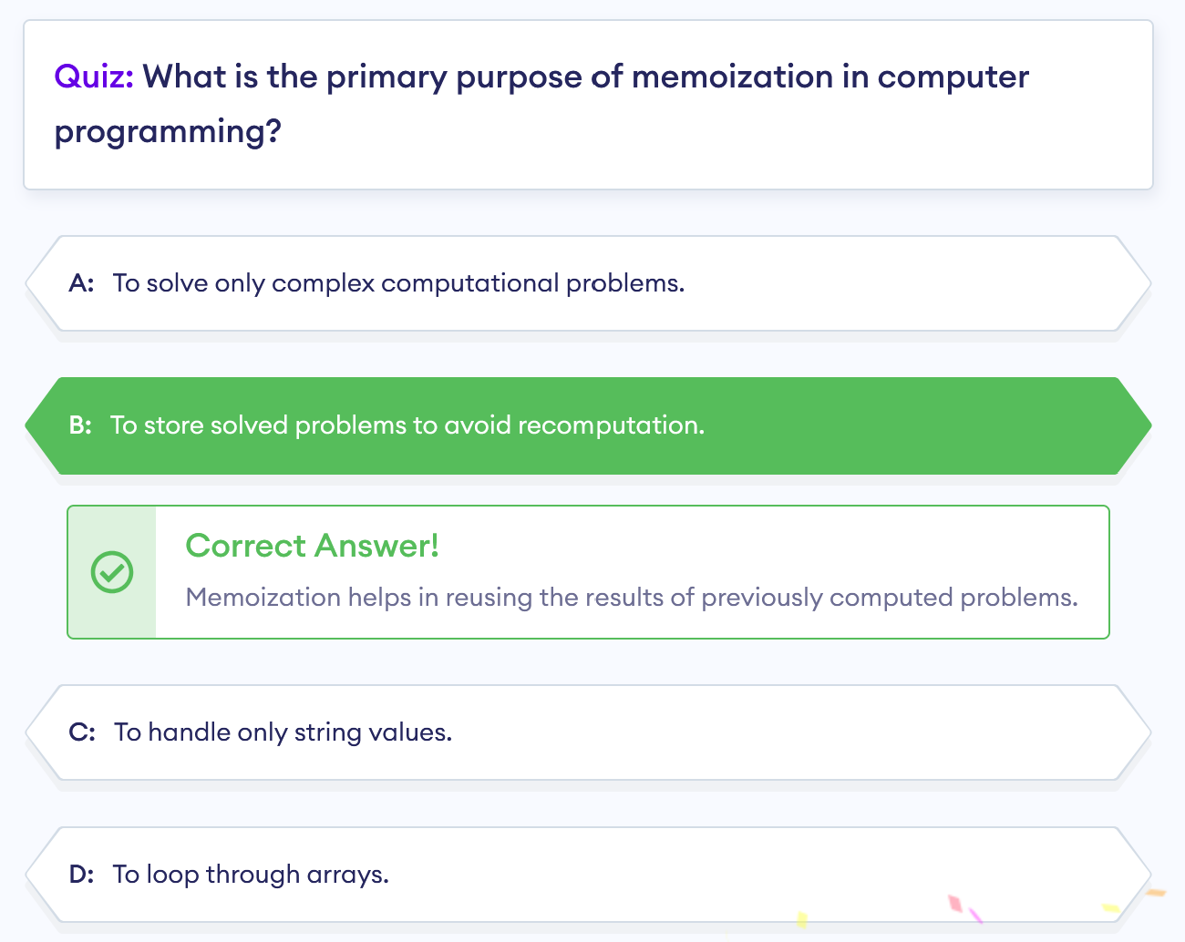

Slide 19
Optimization Problems
For most optimization problems you want to find, not just asolution, but the bestsolution.
●A greedy algorithm sometimes works well for optimization problems. It works in phases. At each phase:
○You take the best you can get right now, without regard for future consequences.
○You hope that by choosing a localoptimum at each step, you will end up at a global optimum.

Slide 20
THE GREEDY PARADIGM
Commit to choices one at a time,
never look back,
and hope for the best.

Slide 21
Greedy Algorithm
A greedy algorithm is a simple approach to solving a problem by selecting the best option at the moment without worrying about the future.
This method works in a top-down approach, where a bigger problem is broken down into smaller parts.

Slide 22
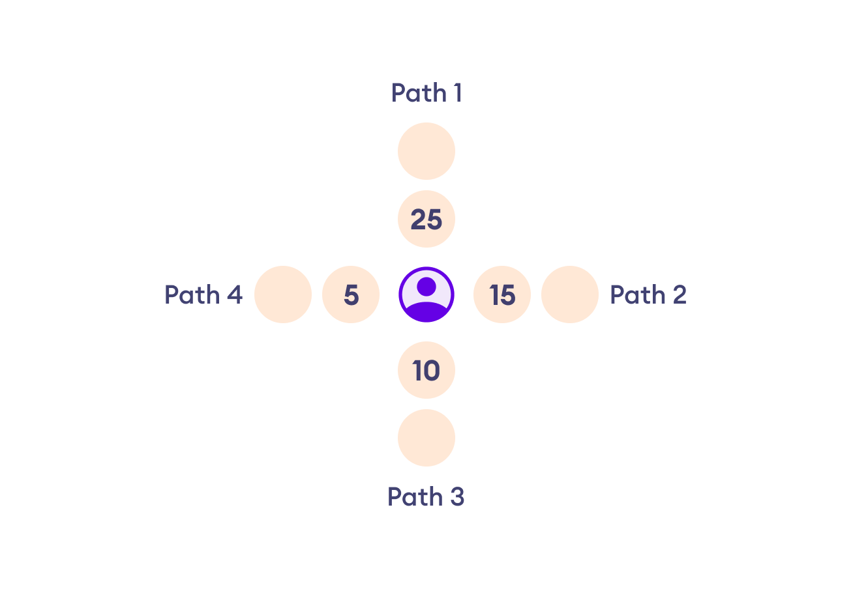
Greedy Algorithm Example
Imagine you are in a room with four exits, and you can only choose one path to exit. Each path has two circles that give you points.
Your goal is to maximize the points. Keep in mind that you can't change a path once you have decided on it.
Figure: Example of Greedy Algorithm

Slide 23
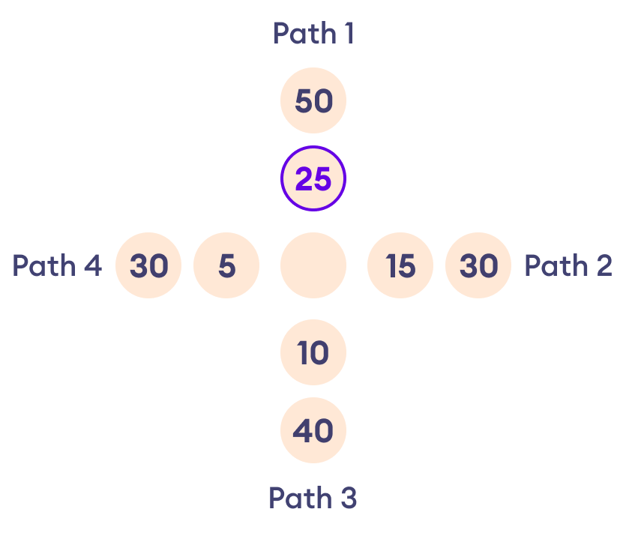
We take the path with the highest point
s in the first circle, which is Path1.
Figure: Choosing Path1

Slide 24
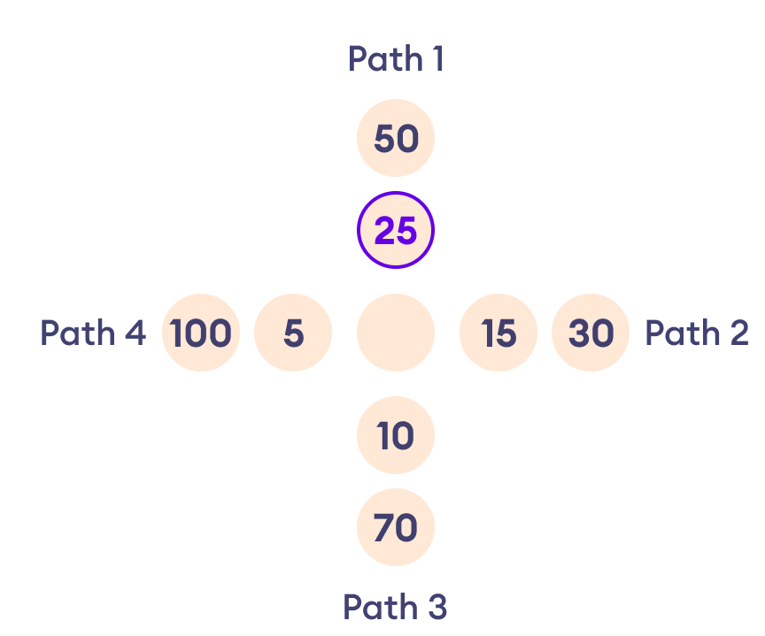
Since we can't change paths now, you end up with the most points, 75 (25 from the first circle and 50 from the second circle).
In this case, the path we chose is optimal but this may not always be the case.
For example, if the path had the values in the figure below, our chosen path wouldn't be the best.
Figure: Greedy Solution isn't Always Optimal

Slide 25
Here Path1 only gives you 75 points whereas Path 4 could have given you 105 points, and Path 3 could have given you 80 points.
Thus, this simple approach may not always get you the most points.
Note: Greedy algorithms like this focus on the best immediate choice, not necessarily the best overall outcome.
Figure: Greedy Solution isn't Always Optimal

Slide 26
Principles of Greedy Algorithms
There are three things to note about greedy algorithms:
Short-Sighted: Greedy algorithms choose the best option at the moment without thinking about the consequences in the future.
No Looking Back: Once a decision is made, greedy algorithms don't change their minds, even if it proves to be a suboptimal choice in the end.
Iterative Approach: Greedy algorithms solve problems step by step, always choosing what looks best right now.

Slide 27
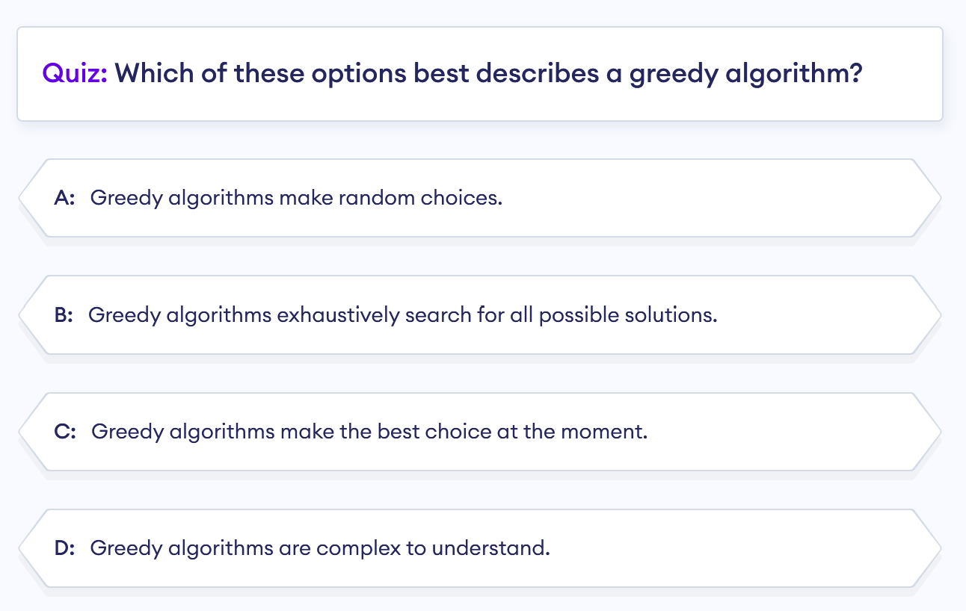

Slide 28
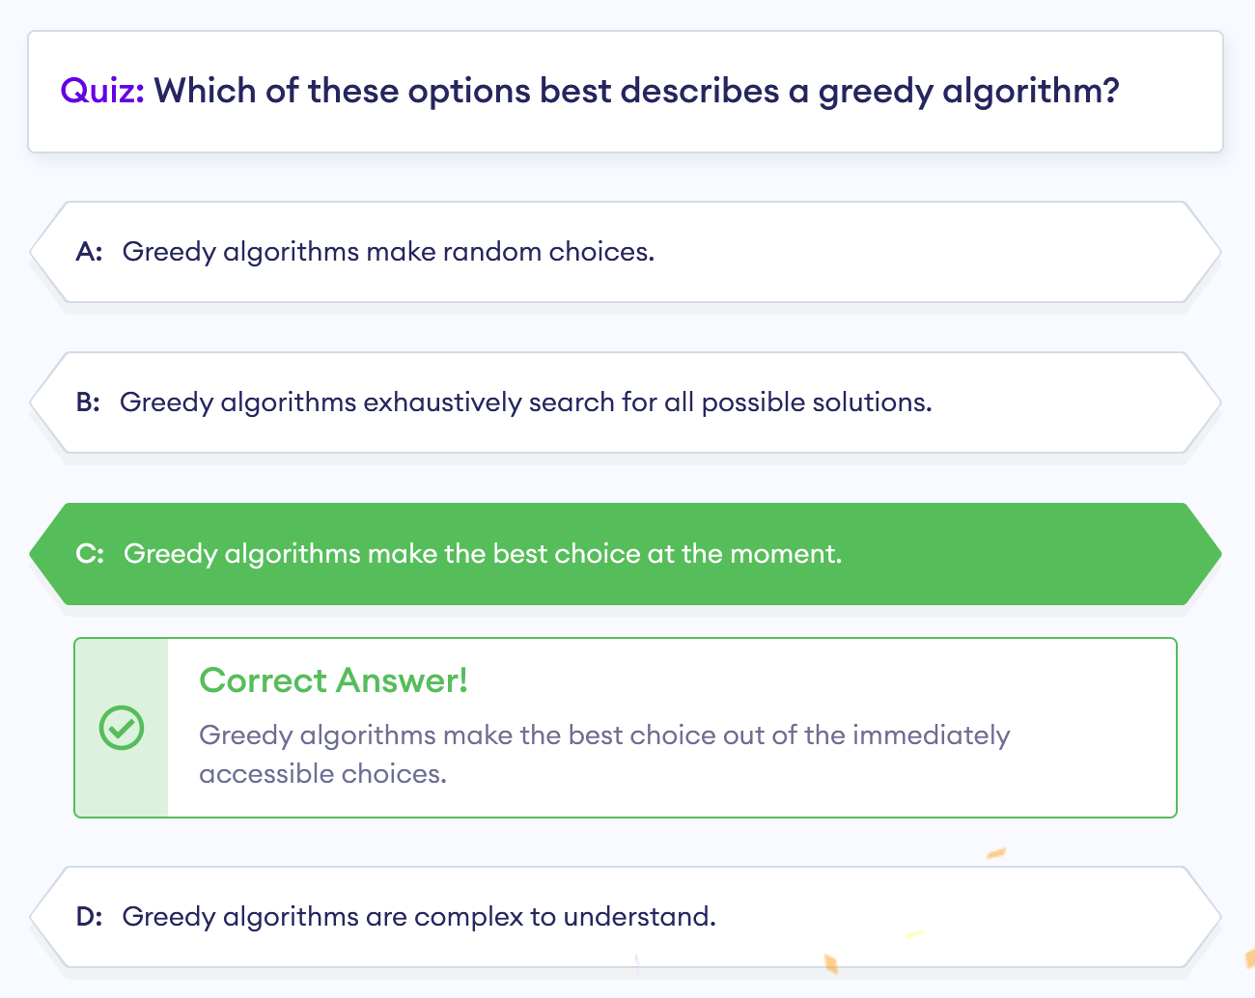

Slide 29
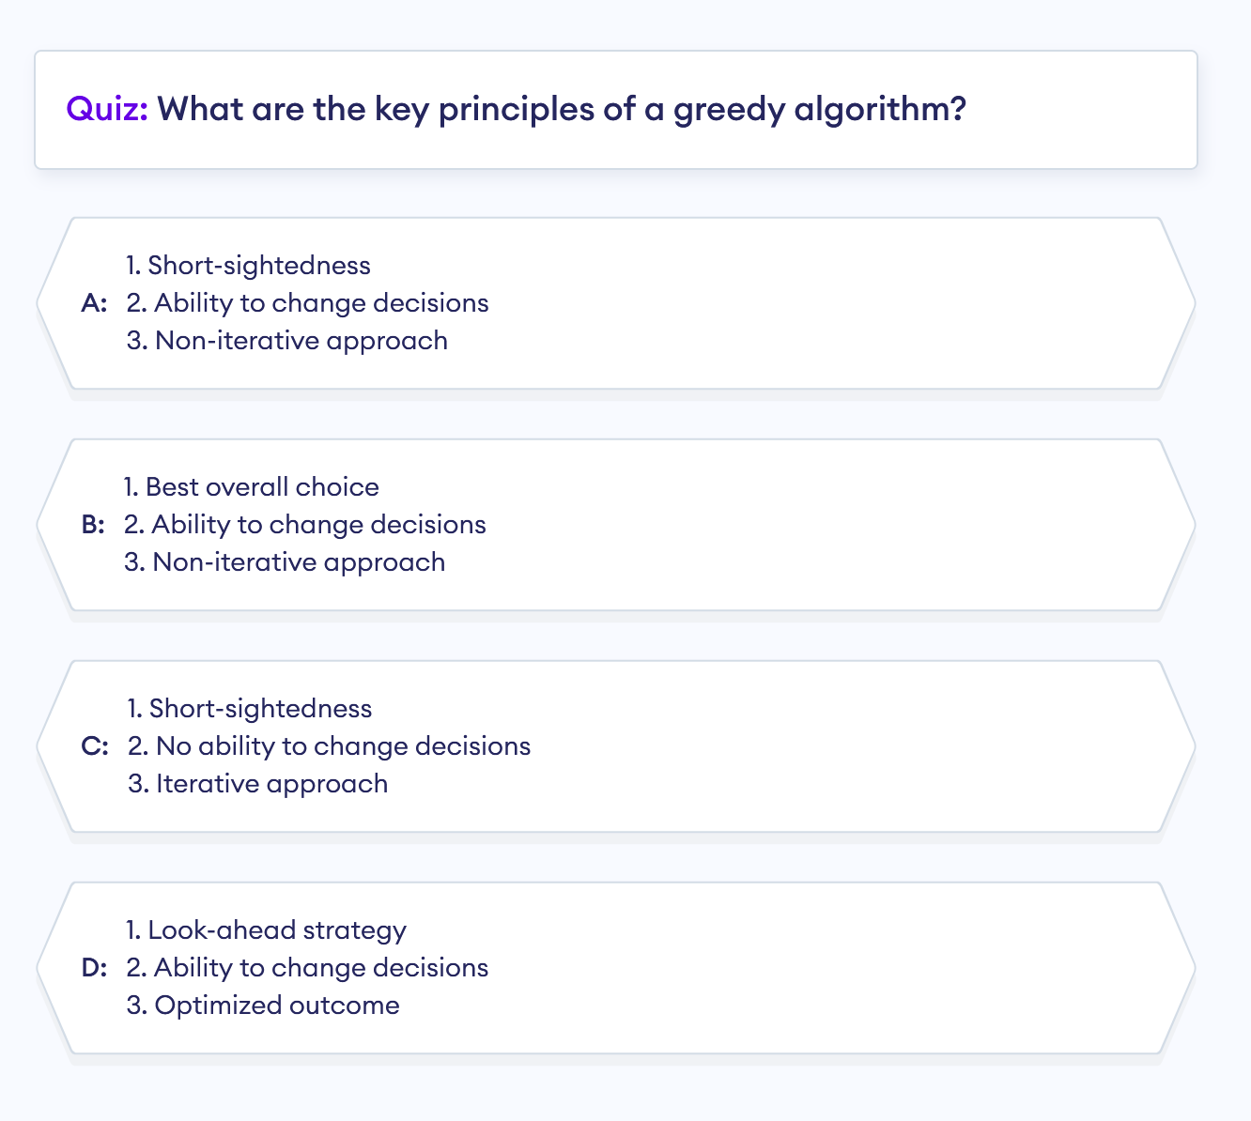

Slide 30
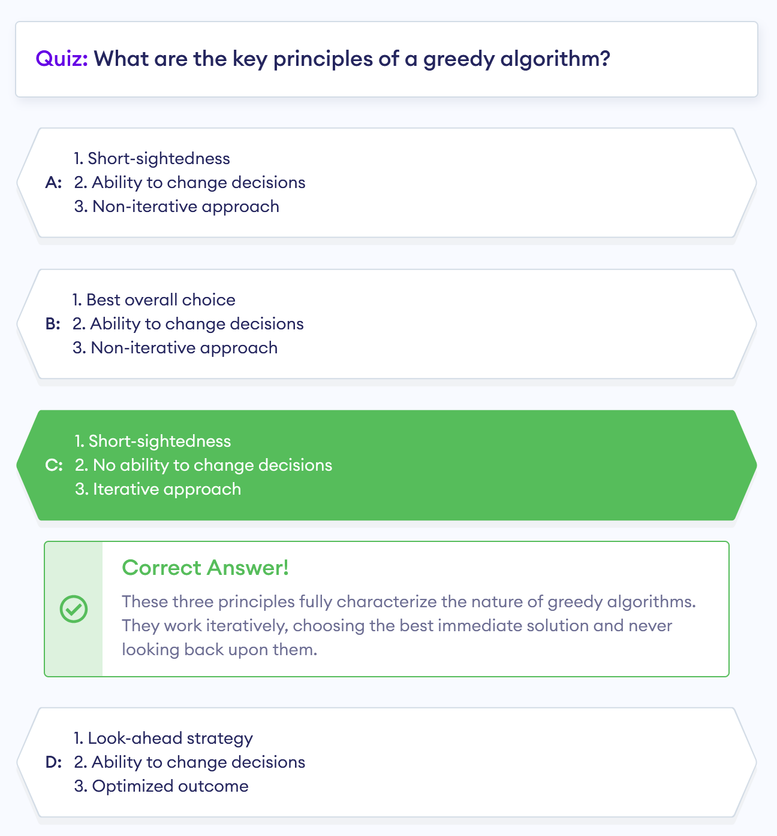

Slide 31
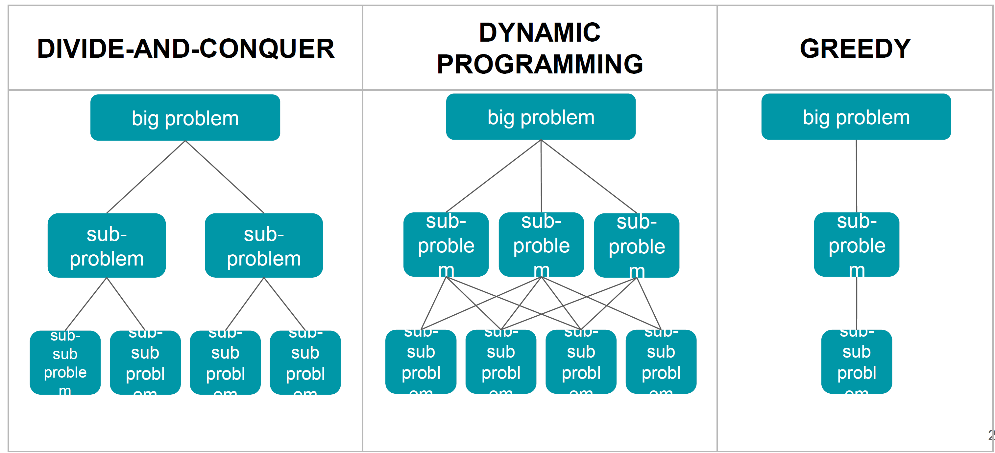
D&C vs. DP vs. GREEDY

Slide 32
References
https://www.programiz.com/dsa/divide-and-conquer
https://www.programiz.com/dsa/dynamic-programming
https://www.programiz.com/dsa/greedy-algorithm
https://www.geeksforgeeks.org/comparison-among-greedy-divide-and-conquer-and-dynamic-programming-algorithm/

